Slide 1


Falowo Gbolahan
14-09-2021

Slide 2
Outline
Executive Summary
Introduction
Methodology
Results
Conclusion
Appendix

Slide 3
Executive Summary
Summary of methodologies
Data collection
Data wrangling
EDA with data visualization
EDA with SQL
Building an interactive map with Folium
Building a Dashboard with Plotly Dash
Predictive analysis (Classification)
Summary of all results
Exploratory data analysis results
Interactive analytics demo in screenshots
Predictive analysis results

Slide 4
Introduction
Project background
We predicted if the Falcon 9 first stage will land successfully. SpaceX advertises Falcon 9 rocket launches on its website, with a cost of 62 million dollars; other providers cost upward of 165 million dollars each, much of the savings is because SpaceX can reuse the first stage. Therefore, if we can determine if the first stage will land, we can determine the cost of a launch. This information can be used if an alternate company wants to bid against SpaceX for a rocket launch.
Problems you want to find answers
What influences if the rocket will land successfully?
The effect each relationship with certain rocket variables will impact in determining the success rate of a successful landing.
What conditions does SpaceX have to achieve to get the best results and ensure the best rocket success landing rate.

Slide 5


Slide 6
Methodology
Data collection methodology:
SpaceX Rest API
(Web Scrapping) from Wikipedia
Performed data wrangling (Transforming data for Machine Learning)
One Hot Encoding data fields for Machine Learning and dropping irrelevant columns
Performed exploratory data analysis (EDA) using visualization and SQL
Plotting : Scatter Graphs, Bar Graphs to show relationships between variables to show patterns of data.
Performed interactive visual analytics using Folium and Plotly Dash
Performed predictive analysis using classification models
How to build, tune, evaluate classification models

Slide 7

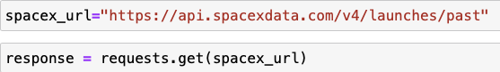
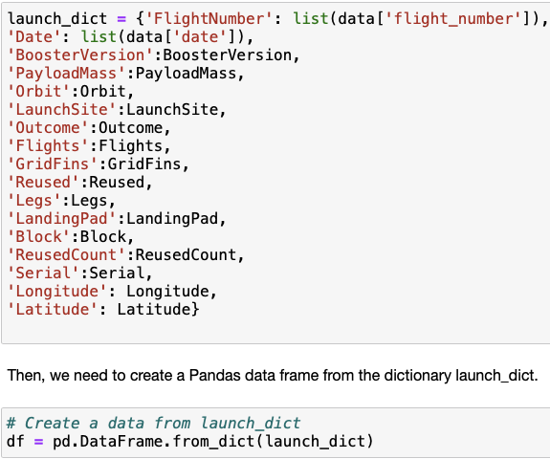
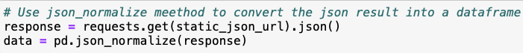
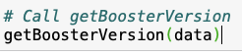
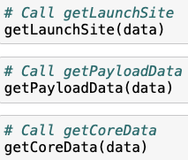
Data Collection – SpaceX API
1.Getting Response from API
4. Create dataframe from dictionary
2.Converting to json format
3.Cleaning data
Add the GitHub URL of the completed SpaceX API calls notebook (must include completed code cell and outcome cell), as an external reference and peer-review purpose
5.Filter and Export to csv file

Slide 8

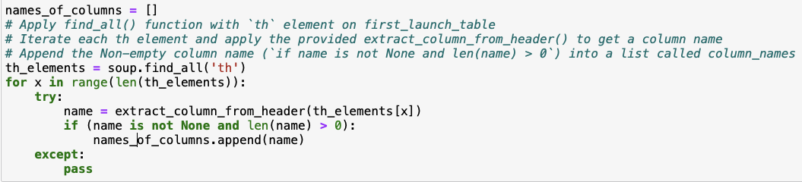
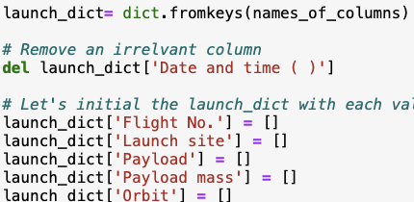
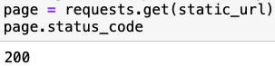
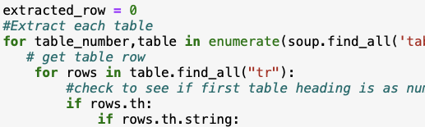
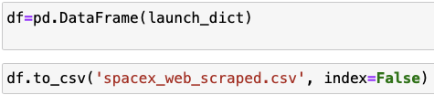
Data Collection - Scraping
3.Finding the tables
4.Get column names
1.Receiving response from html
5.Dictionary creation
2.Creating beautiful soup instance
6.Appending of Data to keys
Add the GitHub URL of the completed web scraping notebook, as an external reference and peer-review purpose
7.Converting to dataframe and then csv file

Slide 9
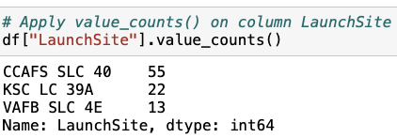
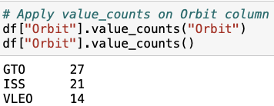
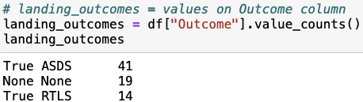
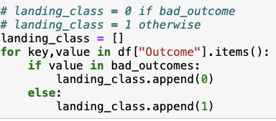
Data Wrangling
Introduction
In our data set we have several different cases where the booster does not land successfully. Sometimes landing has been attempted but failed due to an accident; Ocean means the mission outcome was successfully landed to a specific region of the ocean while False Ocean means the mission outcome was unsuccessfully landed to a specific region of the ocean.
True RTLS means the mission outcome was successfully landed to a ground pad False RTLS means the mission outcome was unsuccessfully landed to a ground pad . True ASDS means the mission outcome was successfully landed to a drone ship False ASDS means the mission outcome was unsuccessfully landed to a drone ship. None ASDS and None None these represent a failure to land.
ASDS means the mission outcome was unsuccessfully landed on a drone ship. We mainly convert those outcomes into Training Labels with 1 means the booster successfully landed 0 means it was unsuccessful.
Add the GitHub URL of your completed data wrangling related notebooks, as an external reference and peer-review purpose
1.Calculate the number of launches on each site
5.Exporting por datatset as a csv file
2.Calculate number and occurrence of each orbit
3.Calculate mission outcome per orbit type
4.Landing Outcome label

Slide 10



EDA with Data Visualization
Bar Graph being drawn:
Mean VS. Orbit
A bar diagram makes it easy to compare sets of data between different groups at a glance.
The graph represents categories on one axis and a discrete value in the other.
The goal is to show the relationship between the two axes.
Bar charts can also show big changes in data over time.
Scatter Graphs being drawn:
Flight Number VS. Launch Site
Flight Number VS. Payload Mass
Payload VS. Launch Site
Payload VS. Orbit Type
Orbit VS. Payload Mass
Orbit VS. Flight Number
Scatter plots show how much one variable is affected by another. The relationship between two variables is called their correlation . Scatter plots usually consist of a large body of data.
Line Graph being drawn:
Success Rate VS. Year
Line graphs are good in representing data variables and trends very clearly and can help to make predictions about the results of data not yet recorded .
Add the GitHub URL of your completed EDA with data visualization notebook, as an external reference and peer-review purpose

Slide 11

EDA with SQL
Performed SQL queries to gather information about the dataset.
For example of some questions we were asked about the data we needed information about. Which we are using SQL queries to get the answers in the dataset :
Displaying the names of the unique launch sites in the space mission
Displaying 5 records where launch sites begin with the string 'KSC’
Displaying average payload mass carried by booster version F9 v1.1
Listing the names of the boosters which have success in ground pad and have payload mass greater than 4000 but less than 6000
Listing the total number of successful and failure mission outcomes
Listing the records which will display the month names, successful landing_outcomes in ground pad ,booster
Ranking the count of successful landing outcomes between the date 2010-06-04 and 2017-03-20 in descending
Displaying the total payload mass carried by boosters launched by NASA (CRS)
Listing the date where the successful landing outcome in drone ship was achieved.
Listing the names of the booster versions which have carried the maximum payload mass.
versions, launch_site for the months in year 2017
Add the GitHub URL of your completed EDA with SQL notebook, as an external reference and peer-review purpose

Slide 12
Build an Interactive Map with Folium
We added a circle marker around each launch site with a a label of the name of the launch sit to represent the launch data into an interactive map.
Represented launch outcome successes with green markers and failures with red markers for easy identification on the map.
To find the distance from launch sites to landmarks we use the Haversines formula to observe different trends about what we have around the launch site. Blue lines have been drawn to highlight distances between entities.
After you plot distance lines to the proximities, you can answer the following questions easily:
Are launch sites in close proximity to railways? No
Are launch sites in close proximity to highways? No
Are launch sites in close proximity to coastline? Yes
Do launch sites keep certain distance away from cities? Yes
Add the GitHub URL of your completed interactive map with Folium map, as an external reference and peer-review purpose

Slide 13
Build a Dashboard with Plotly Dash
Graphs
Pie Chart showing the total launches by sites.
Display relative proportions of multiple classes of data. - size of the circle can be made proportional to the total quantity it represents.
A Scatter Graph was used to highlight the relationship with Payload Mass (Kg) and Outcome for the different Booster Versions
It shows the relationship between two given variables.
A very good way to communicate a non-linear pattern
It highlights the data flow.(the min and max values can be determined)
Reading and observations are easy to spot.
Add the GitHub URL of your completed Plotly Dash lab, as an external reference and peer-review purpose

Slide 14
Predictive Analysis (Classification)
Add the GitHub URL of your completed predictive analysis lab, as an external reference and peer-review purpose
BUILDING MODEL
Load our dataset into NumPy and Pandas
Transform Data
Split our data into training and test data sets
Check how many test samples we have
Decide which type of machine learning algorithms we want to use
Set our parameters and algorithms to GridSearchCV
Fit our datasets into the GridSearchCV objects and train our dataset.
EVALUATING MODEL
Check accuracy for each model
Get tuned hyperparameters for each type of algorithms
Plot Confusion Matrix
IMPROVING MODEL
Feature Engineering
Algorithm Tuning
FINDING THE BEST PERFORMING CLASSIFICATION MODEL
The model with the best accuracy score wins the best performing model
In the notebook there is a dictionary of algorithms with scores at the bottom of the notebook.

Slide 15
Results
Exploratory data analysis results
Interactive analytics demo in screenshots
Predictive analysis results

Slide 16


Slide 17
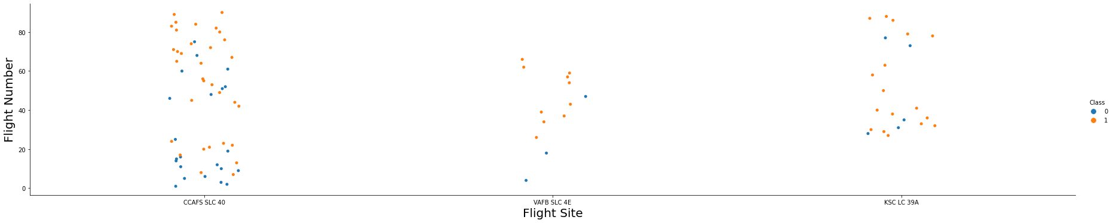
Flight Number vs. Launch Site
The increase in the amount of flights at a launch site the the higher succes rate at a launch site

Slide 18
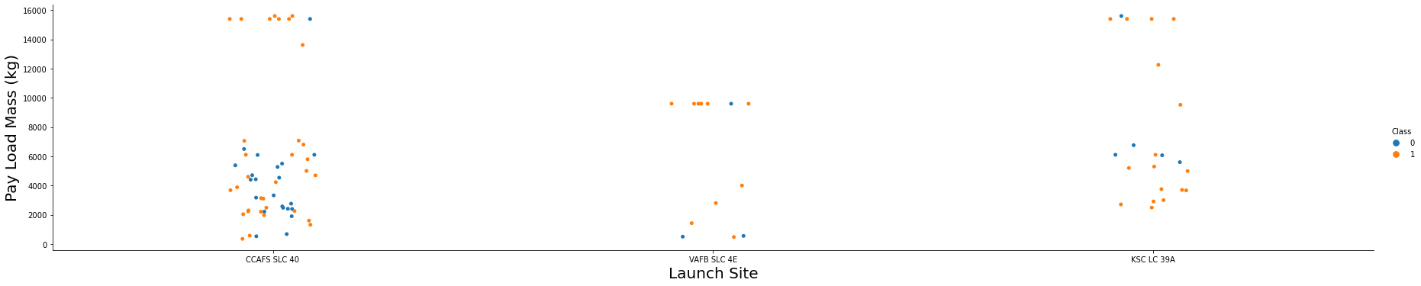
Payload vs. Launch Site
The increase in payload mass for Launch Site CCAFS SLC 40 the higher the success rate for the Rocket.
A clear pattern has not been found using this visualization to infer that the Launch Site is dependant on the Pay Load Mass for a success launch.

Slide 19
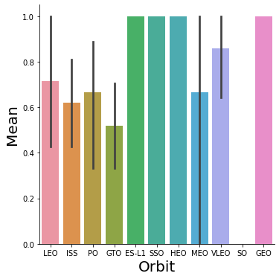
Success Rate vs. Orbit Type
Orbit GEO,HEO,SSO,ES-L1 have the best Success Rates

Slide 20
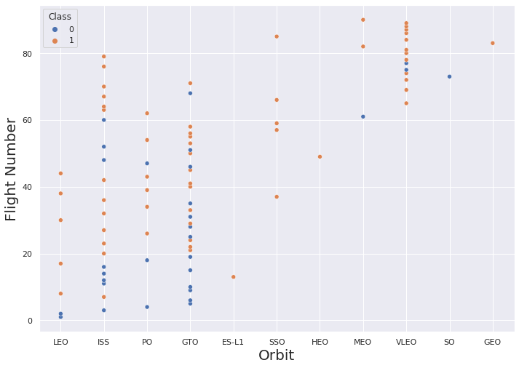
Flight Number vs. Orbit Type
Observations indicate that in the LEO orbit the Success rate appears to relate to the number of flights
Alternatively, there seems to be no clear relationship between flight number when in GTO orbit

Slide 21
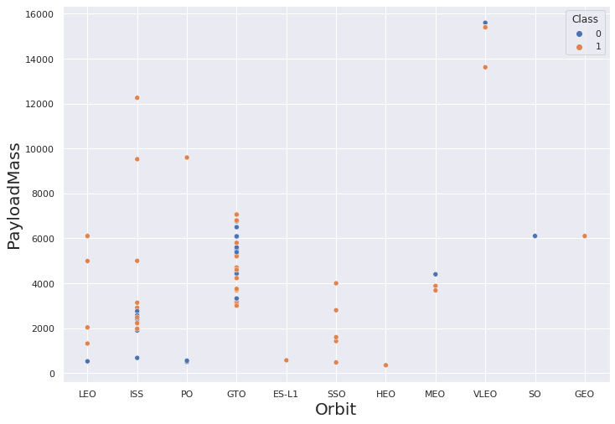
Payload vs. Orbit Type
Observation indicates Heavy payloads have a negative effect on GTO orbits and positive effect on GTO and Polar LEO (ISS) orbits.

Slide 22
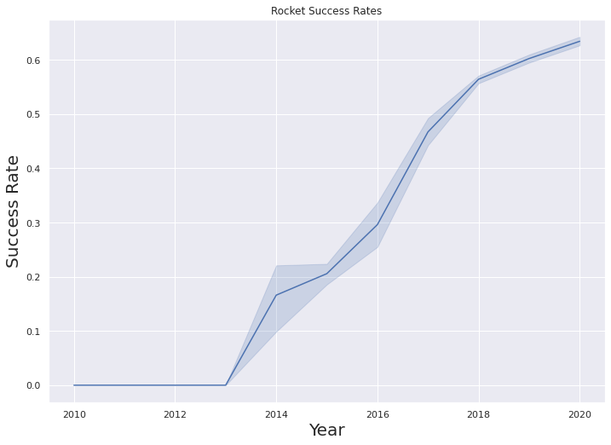
Launch Success Yearly Trend
Observations indicate that the success rate from 2013 kept increasing till 2020

Slide 23
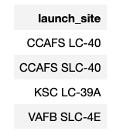
All Launch Site Names
QUERY EXPLAINATION
Using the word DISTINCT in the query means that it will only show Unique values in the Launch_Site column from SPACEXDATASET

Slide 24
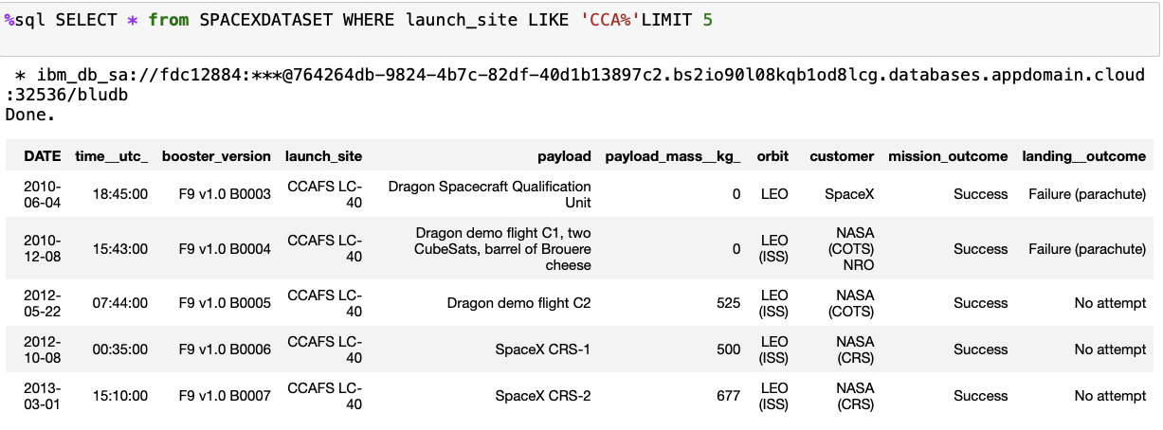
Launch Site Names Begin with 'CCA'
QUERY EXPLAINATION
Using the word LIMIT in the query means that it will only show 5 records from SPACEXDATASET and LIKE keyword has a wild card with the words ‘CCA%’ the percentage in the end suggests that the Launch_Site name must start with CCA.

Slide 25
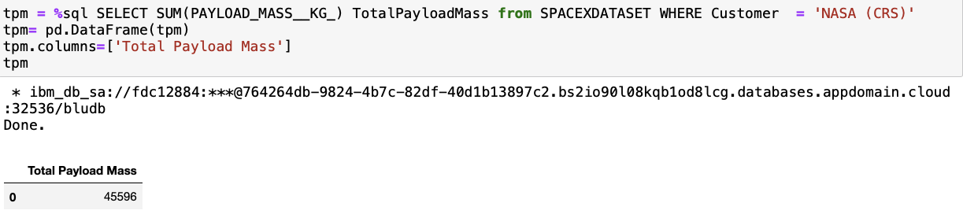
Total Payload Mass
QUERY EXPLAINATION
Using the function SUM summates the total in the column PAYLOAD_MASS_KG_
The WHERE clause filters the dataset to only perform calculations on Customer NASA (CRS)

Slide 26
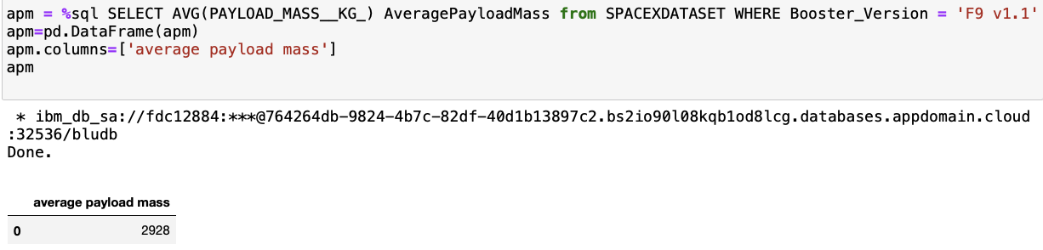
Average Payload Mass by F9 v1.1
QUERY EXPLAINATION
Using the function AVG works out the average in the column PAYLOAD_MASS_KG_
The WHERE clause filters the dataset to only perform calculations on Booster_version F9 v1.1

Slide 27
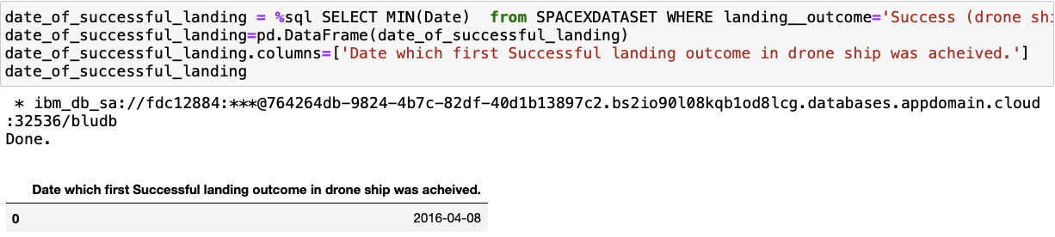
First Successful Ground Landing Date
QUERY EXPLAINATION
Using the function MIN works out the minimum date in the column Date
The WHERE clause filters the dataset to only perform calculations on Landing__Outcome Success (drone ship)

Slide 28
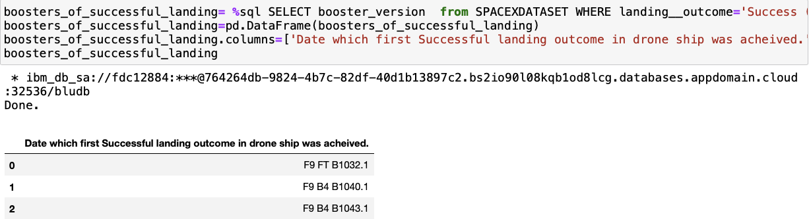
Successful Drone Ship Landing with Payload between 4000 and 6000
%sql SELECT booster_version from SPACEXDATASET WHERE landing__outcome='Success (ground pad)' AND payload_mass__kg_ > 4000 AND payload_mass__kg_ < 6000
QUERY EXPLAINATION
Selecting only Booster_Version The WHERE clause filters the dataset to Landing__Outcome =
Success (drone ship) The AND clause specifies additional filter conditions
Payload_MASS__KG_ > 4000 AND Payload_MASS__KG_ < 6000

Slide 29
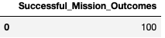
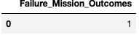
Total Number of Successful and Failure Mission Outcomes
SELECT(SELECT Count(Mission_Outcome) from tblSpaceX where Mission_Outcome LIKE '%Success%’) as Successful_Mission_Outcomes, (SELECT Count(Mission_Outcome) from tblSpaceX where Mission_Outcome LIKE '%Failure%’) as Failure_Mission_Coutcomes
QUERY EXPLAINATION
a much harder query I must say, we used subqueries here to produce the results. The LIKE ‘%foo%’ wildcard shows that in the record the foo phrase is in any part of the string in the records for example.

Slide 30
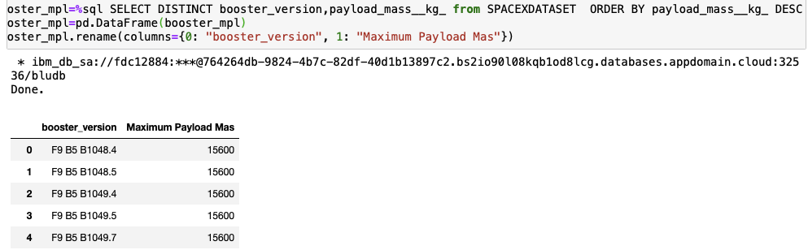
Boosters Carried Maximum Payload
QUERY EXPLAINATION
Using the word DISTINCT in the query means that it will only show Unique values in the Booster_Version column from SPACEXDATASET ORDER BY puts the list in order set to a certain condition. DESC means its arranging the dataset into descending order

Slide 31
2015 Launch Records
SELECT DATENAME(month, DATEADD(month, MONTH(CONVERT(date, Date, 105)), 0) - 1) AS Month, Booster_Version, Launch_Site, Landing_Outcome FROM SPACEXDATASET
WHERE (Landing_Outcome LIKE N'%Success%') AND (YEAR(CONVERT(date, Date, 105)) = ‘2015')
QUERY EXPLAINATION
a much more complex query as I had my Date fields in SQL Server stored as NVARCHAR the MONTH function returns name month. The function CONVERT converts NVARCHAR to Date.
WHERE clause filters Year to be 2015

Slide 32
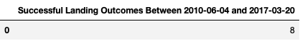
Rank Landing Outcomes Between 2010-06-04 and 2017-03-20
SELECT Count(landing__outcome) AS sl FROM SPACEXDATASET WHERE (landing__outcome LIKE '%Success%') AND (DATE >'2010-06-04') AND (DATE < '2017-03-20’)
QUERY EXPLAINATION
Function COUNT counts records in column WHERE filters data
LIKE (wildcard)
AND (conditions)
AND (condition

Slide 33


Slide 34
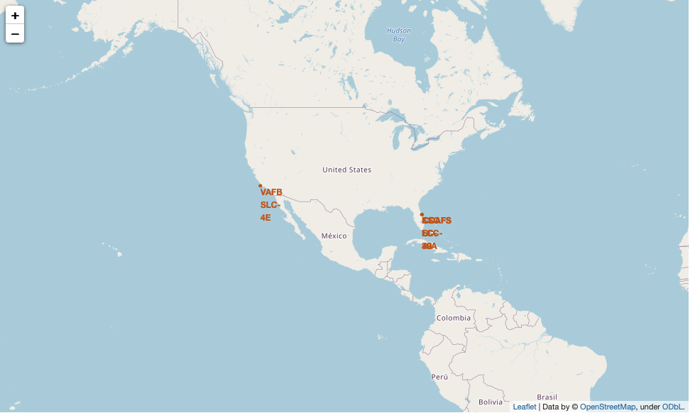
All launch sites global map markers
We can observe that the launch sites are in the United States of America.
California,Florida

Slide 35
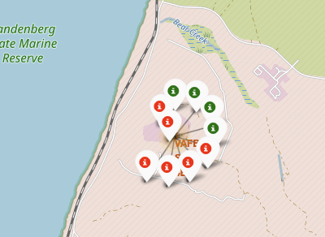
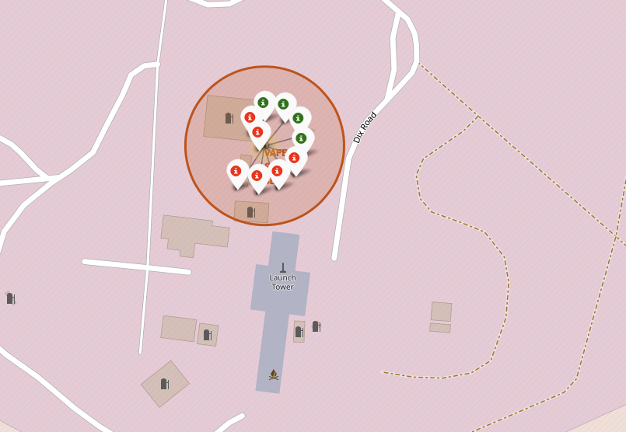
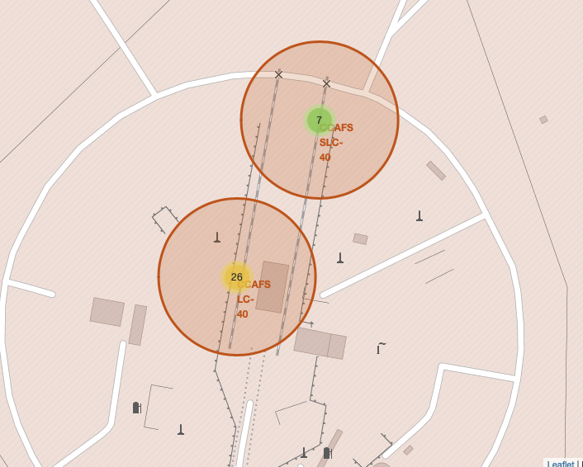
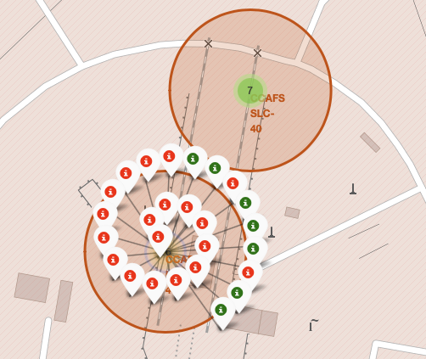
Color Labelled Markers
California Launch Sites
Florida Launch Sites
Green Marker shows successful Launches and Red Marker shows Failures

Slide 36
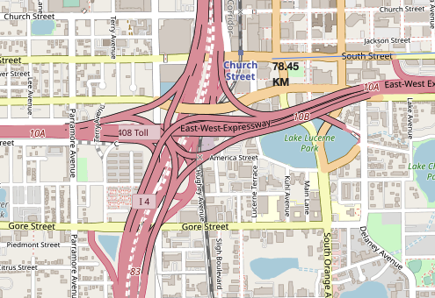
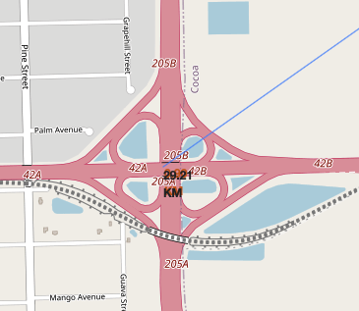
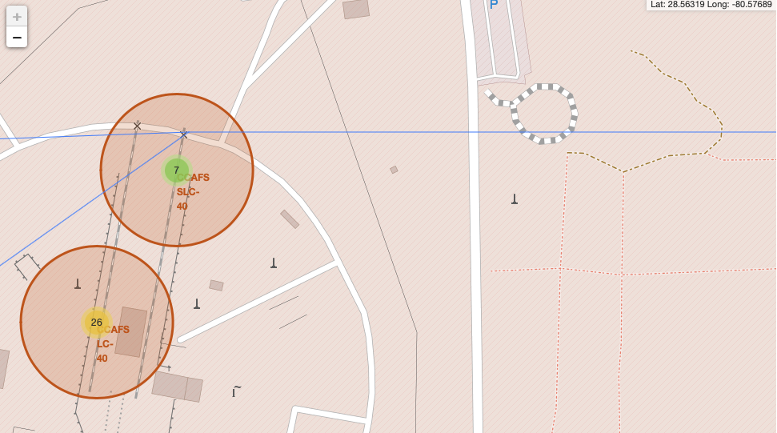
Determining Launch Site Distance using Haversine formula
Distance to City
Distance to the closest Highway
Distance to the coast
Are launch sites in close proximity to railways? No
Are launch sites in close proximity to highways? No
Are launch sites in close proximity to coastline? Yes
Do launch sites keep certain distance away from cities? Yes

Slide 37


Slide 38

Dashboard with Plotly Dash
It can be observed that KSC LC-39A has the most successful launches from all the sites

Slide 39
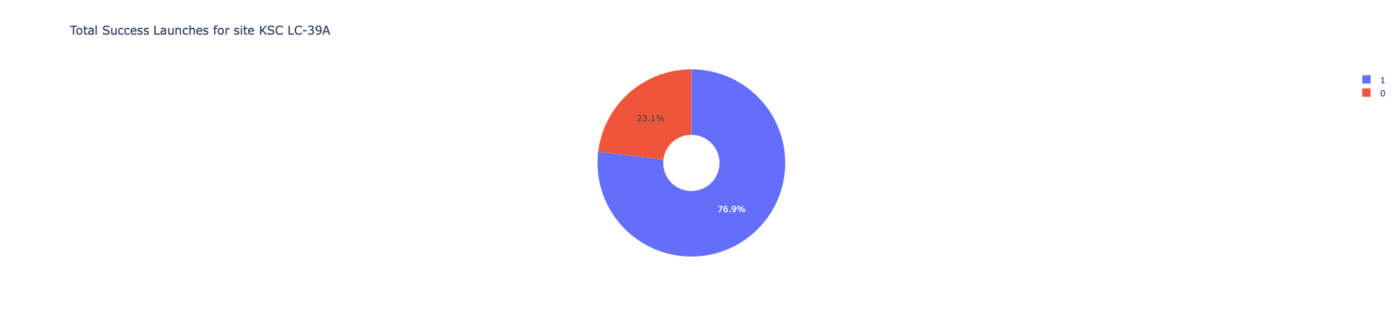
Launch site with highest launch success ratio
KSC LC-39A achieved a 76.9% success rate while getting a 23.1% failure rate

Slide 40
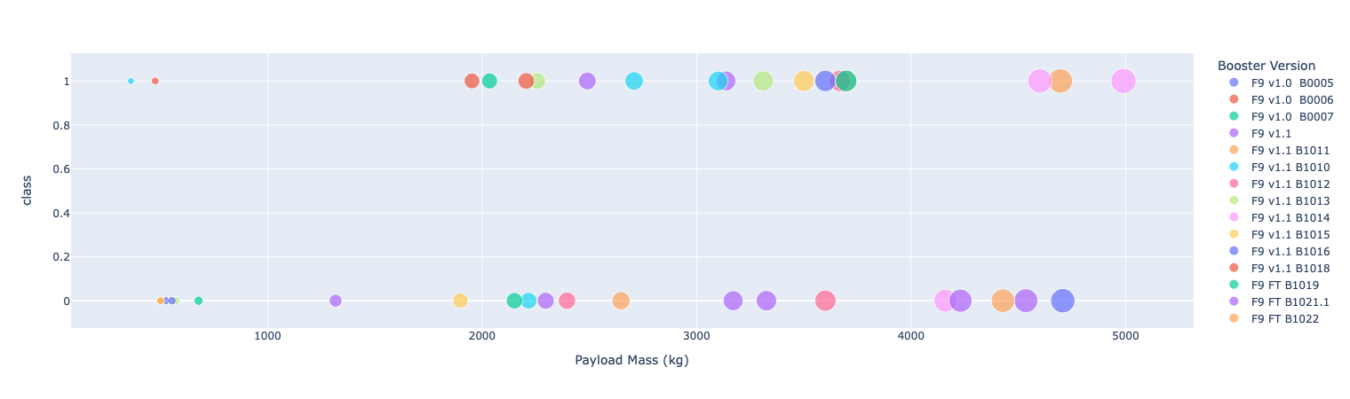
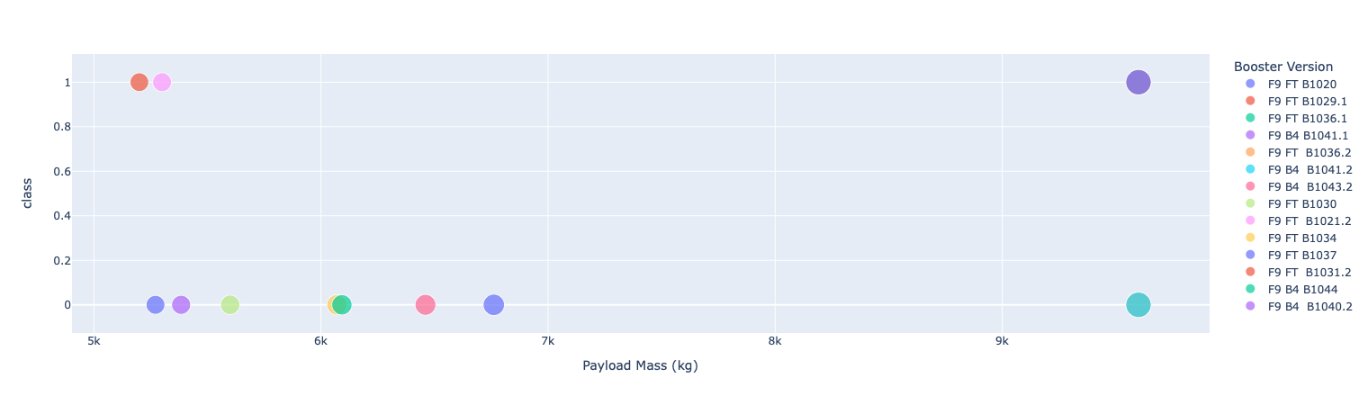
DPayload vs. Launch Outcome scatter plot for all sites, with different payload selected in the range slider
Low Weighted Payload 0kg – 5000kg
Heavy Weighted Payload 5000kg – 10000kg
We can see the success rates for low weighted payloads is higher than the heavy weighted payloads

Slide 41


Slide 42
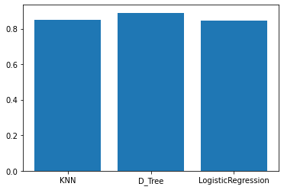
Classification Accuracy
Best Algorithm is D_Tree with a score of 0.8892857142857145

Slide 43
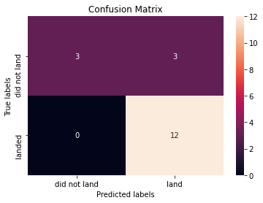
Confusion Matrix
Examining the confusion matrix, we see that Tree can distinguish between the different classes. We see that the major problem is false positives.

Slide 44
Conclusions
Low weighted payloads perform better than the heavier payloads
The success rates for SpaceX launches is directly proportional time in years they will eventually perfect the launches
We can see that KSC LC-39A had the most successful launches from all the sites
The Tree Classifier Algorithm is the best for Machine Learning for this dataset.

Slide 45


